Slide 1


Huazhong University of Science and Technology
The Department of Electronics and Information Engineering
Electronic Circuit Analysis and Design
Dr. Tianping Deng
Email: dengtp@hust.edu.cn

Slide 2
Contents
PART 1 SEMICONDUCTOR DEVICES AND BASIC APPLICATIONS
Chapter 1 Semiconductor Materials and Diodes
Chapter 2 Diode Circuits
Chapter 3 The Field-Effect Transistor
Chapter 4 Basic FET Amplifiers
Chapter 5 The Bipolar Junction Transistor
Chapter 6 Basic BJT Amplifiers
Chapter 7 Frequency Response
Chapter 8 Output Stages and Power Amplifiers
PART 2 ANALOG ELECTRONICS
Chapter 9 Ideal Operational Amplifiers and Op-Amp Circuits
Chapter 10 Integrated Circuit Biasing and Active Loads
Chapter 11 Differential and Multistage Amplifiers
Chapter 12 Feedback and Stability
Chapter 13 Operational Amplifier Circuits
Chapter 14 Nonideal Effects in Operational Amplifier Circuits
Chapter 15 Applications and Design of Integrated Circuits
Chapter 7 Frequency Response

Slide 3
Ch7 Frequency Response
(P471-486)
7.1 Amplifier Frequency Response
7.2 System Transfer Functions
7.3 Frequency Response：Transistor Amplifier with Circuit Capacitors
7.4 Frequency Response：Bipolar Transistor
7.5 Frequency Response：FET
7.6 High-Frequency Response of Transistor Circuits

Slide 4
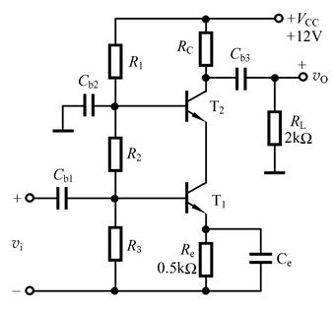
Ch7 Frequency Response
Why we consider frequency response of amplifier
In previous analysis of amplifier, all capacitors were not considered.
To AC equivalent circuit
Coupling and bypass capacitors are short
To DC equivalent circuit .
Coupling and bypass capacitors are open
Internal capacitances, junction capacitances, in BJT were not considered.

Slide 5
Ch7 Frequency Response（P472)
A three-way audio speaker system has
  Woofer - low frequency signal
  Mid-band speakers – mid-frequency signal
  Tweeter - high frequency signal
Circuits with specific response characteristics
Pass some frequency bands; reject others
Tweeter
Mid-range
Audio Signal
Woofer

Slide 6


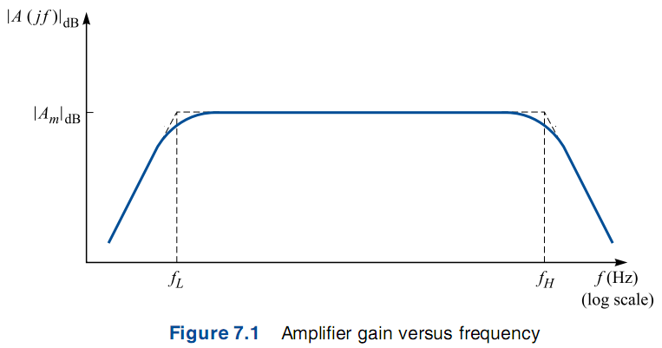






Ch7 Frequency Response（P472)

Slide 7

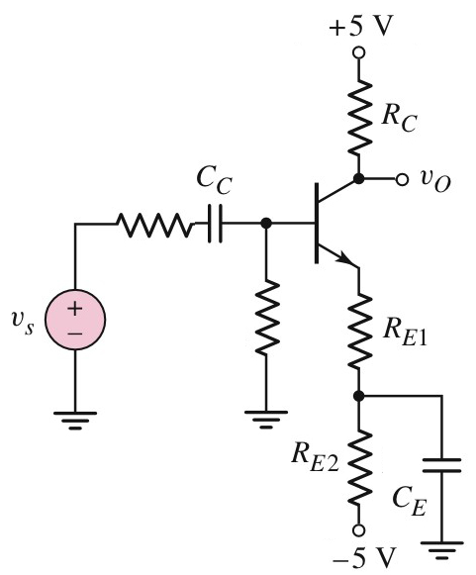
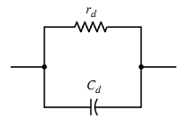

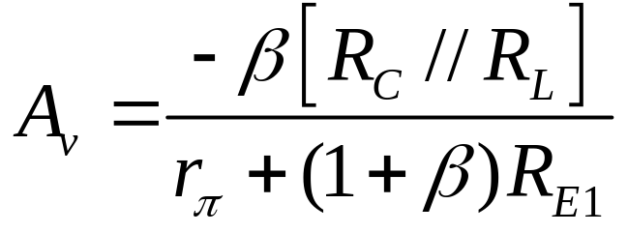
7.1.1 Equivalent Circuit（P473)
C_{C}, C_{E}
C_{BE}, C_{BC}
Short
Open
C_{C}, C_{E}
C_{BE}, C_{BC}
not
Short
Open
C_{C}, C_{E}
C_{BE}, C_{BC}
Short
Not Open

Slide 8


7.1.2 Frequency Response Analysis（P473)
+
+

Slide 9

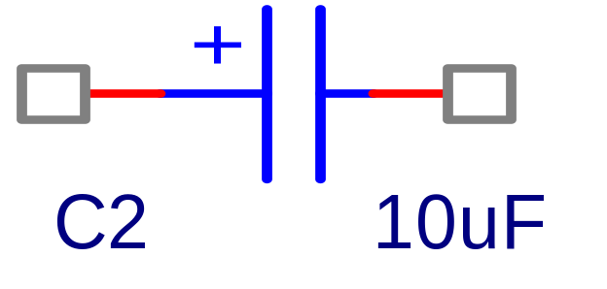
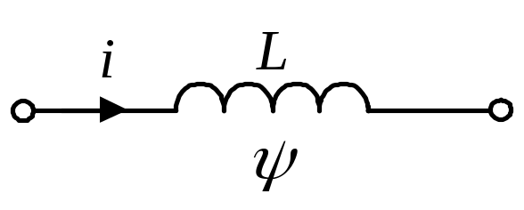
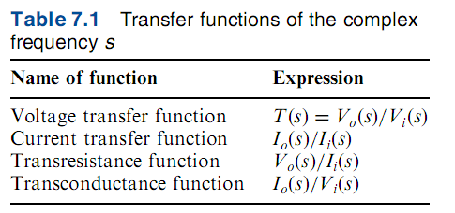

7.2 System Transfer Functions(P474)

Slide 10


7.2.1 s-Domain Analysis (P475)
Zeros
poles

Slide 11
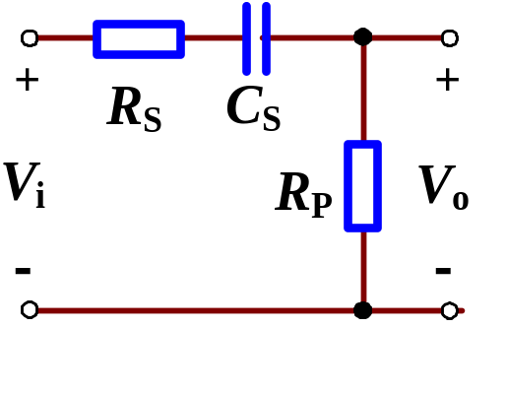

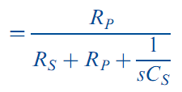





7.2.1 s-Domain Analysis (P475)
Voltage transfer function

Slide 12
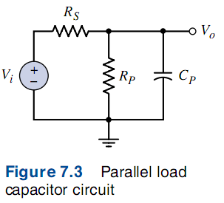

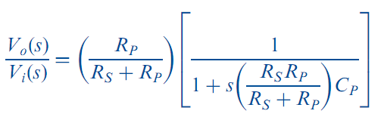


7.2.1 s-Domain Analysis (P475)
Voltage transfer function

Slide 13
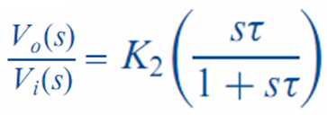
7.2.2 First-order Functions (P476)
Only one Capacitance

Slide 14



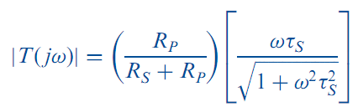
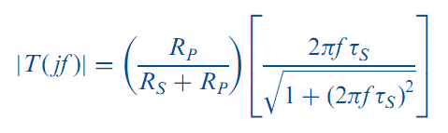
7.2.3 Bode Plots (P477)

Slide 15
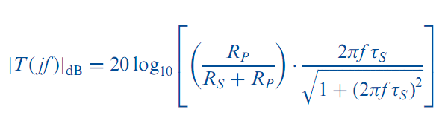
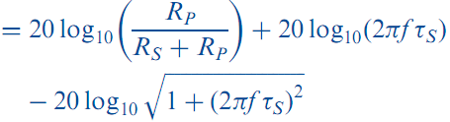

7.2.3 Bode Plots (P478)

Slide 16
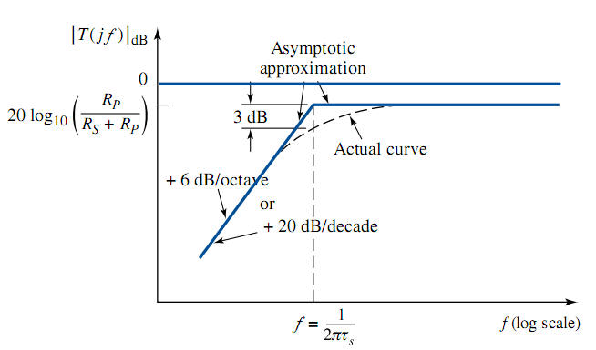

7.2.3 Bode Plots (P478)
High-pass or low-pass ?
High-pass

Slide 17
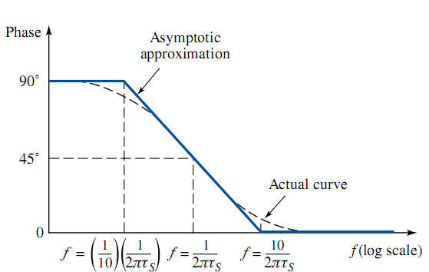
7.2.3 Bode Plots (P479)

Slide 18
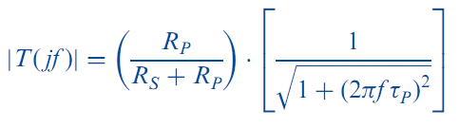
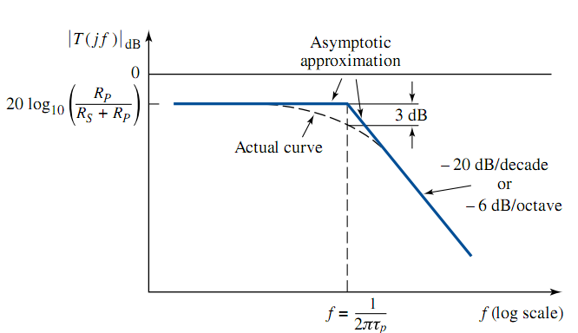

7.2.3 Bode Plots (P480)
High-pass or low-pass ?
Low-pass

Slide 19

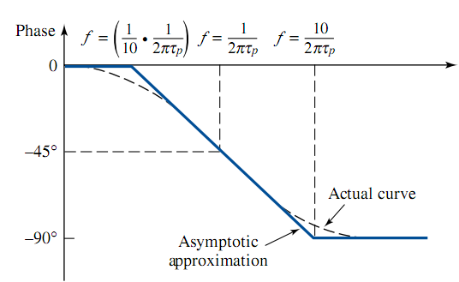
7.2.3 Bode Plots (P481)

Slide 20
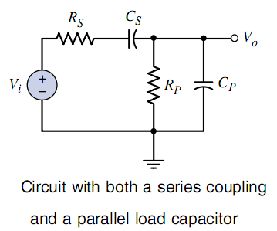
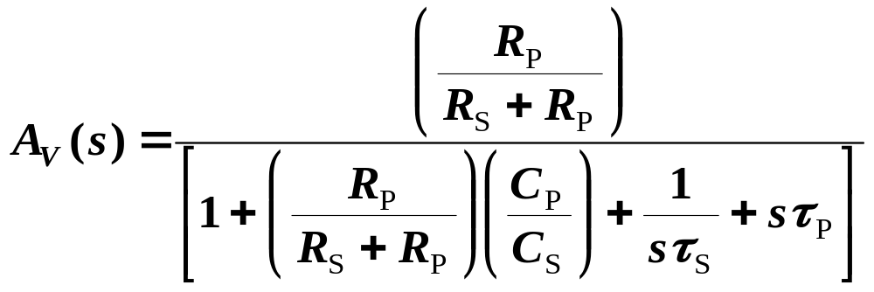

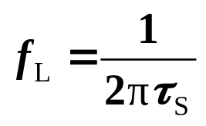

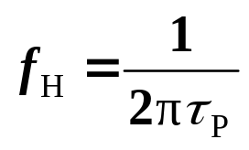
7.2.4 Short- and Open-Circuit Time Constant(P483)
Voltage transfer function
At low frequency, C_{P} is open, circuit is simplified high-pass network.
__open-circuit time constant.
__Lower corner.
At high frequency, C_{S} is short, circuit is simplified low-pass network.
__short-circuit time constant.
__Upper corner.

Slide 21









7.2.4 Short- and Open-Circuit Time Constant(P483)

Slide 22
Questions
and
Answers

